Slide 1
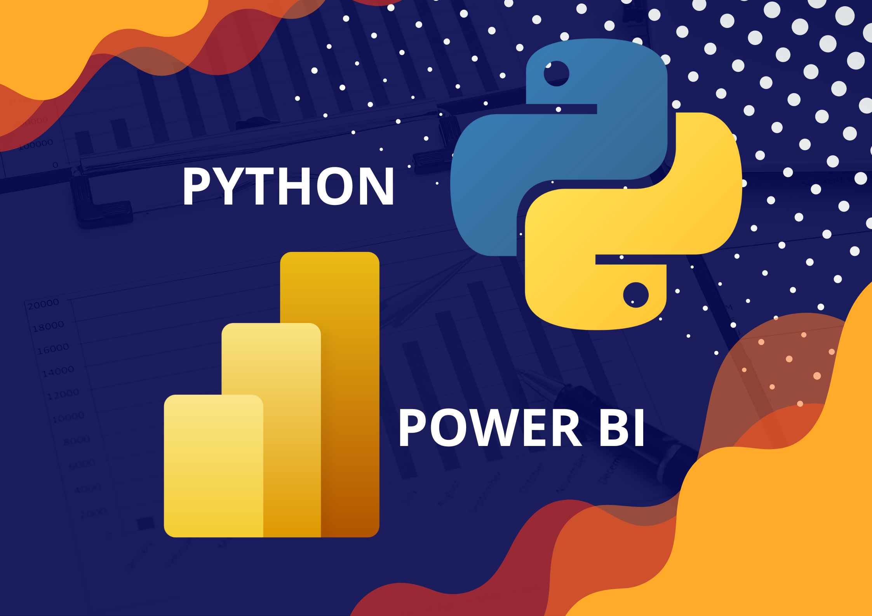
Power BI & Python

Slide 2
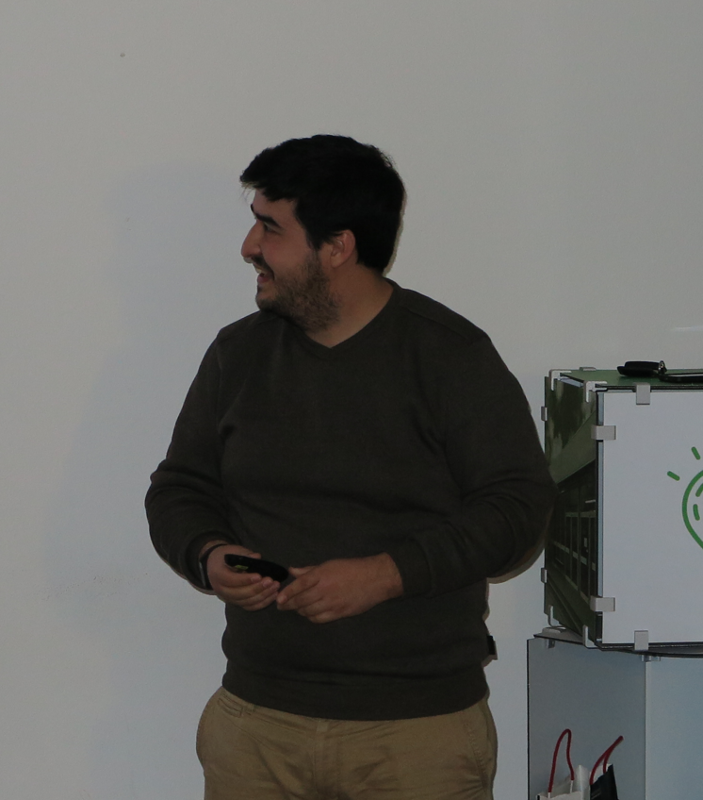




About me
Masters and PhD on Artificial Intelligence and Machine Learning
Researcher at IT Aveiro
Areas of interest: Artificial Intelligence, Machine Learning, text mining, stream mining, IoT, M2M, ...

Slide 3
Why Use Python in Power BI?
Using Python with Power BI introduces a whole new set of possibilities for working with data. Python turns Power BI into a platform that can do almost anything.

Slide 4
Why Use Python in Power BI?
Data cleaning - you can write Python scripts that automate some of the more repetitive data cleaning tasks that you commonly perform such as removing missing values or correcting date formats.
Data transformation - Python scripts are helpful for datasets that require more extensive data transformations, which may be slow or cumbersome to do in the Power Query Editor, before they can be imported.
Machine learning - enriching your data with predictive analytics (such as regression or natural language processing), or unsupervised machine learning tasks like cluster analysis.
Handling of missing data - Python gives you more options for how you want to handle missing data, such as using machine learning models.
Advanced visualizations - there is no restriction to the type of visualization you can add to your report when using Python. Add highly complex or customized visualizations without needing to download custom visuals in Power BI.
Connectivity - Python gives you the ability to connect to almost any data source even if Power BI does not support it as one of its own built-in connections.

Slide 5
Limitations
Data sources added with Python must be set to public.
Only Pandas DataFrames can be imported into Power BI using Python.
Scripts that take longer than 30 minutes to run will time out, as will Python visuals that take more than 5 minutes to run.
There are a limited number of Python libraries supported by Power BI Service.
Reports using Python can only be refreshed in Power BI Service through a personal gateway (the enterprise or standard gateway is not supported).
Python visuals do not support cross-filtering. This means that selecting an element in a Python visual will not cause other visuals to filter by that selection, thus removing some degree of interactivity in the Power BI report.

Slide 6
Setup

Slide 7
Setup
Install Power BI from Windows store, here.
Install the latest Python interpreter, here.
During the installation process, add Python to the PATH
Run the following commands on a CMD terminal:
pip install lxml numpy openpyxl pandas matplotlib seaborn scikit-learn

Slide 8
Python Introduction

Slide 9
Python 101
Python is a general-purpose programming language that is becoming ever more popular for data science.
It is a verbose language that is easy to read
Uses indentation to define the scope of a function
One of the largest collection of libraries available
Resources:
W3Schools
Python 101

Slide 10

NumPy
Also known as Numerical Python, designed to offer the same functionally as Matlab into a python environment
A low-level library that allows users to access several matrices based operations
Can speedup the code execution considerably

Slide 11
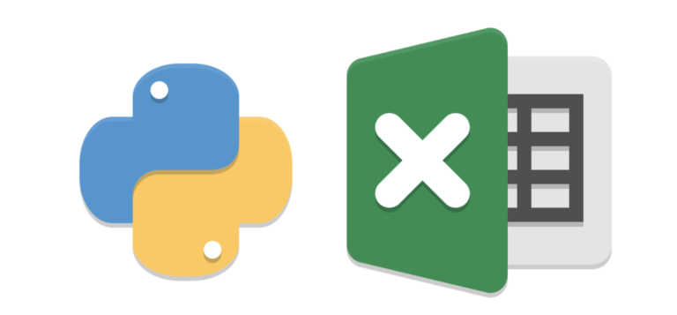
Openpyxl
A Python library to read/write Excel 2010 files
It was born from lack of existing library to read/write natively from Python the Office Open XML format.

Slide 12

Pandas
Is a fast, powerful, flexible and easy to use open-source data analysis and manipulation tool, built on top of the Python programming language.
A Pandas DataFrame is a 2-dimensional data structure, like a 2-dimensional array, or a table with rows and columns.
The data structure is understood by Power Bi
It is the standard library to use on loading and cleaning data

Slide 13

Matploblib
Is a comprehensive library for creating static, animated, and interactive visualizations in Python.
Offers the same functionality as gnuplot into a Python environment
Allows to draw any type of visualization
Some libraries are built on-top of it to ease the development of specific plots:
Seaborn
Plotly

Slide 14

Scikit-learn
Simple and efficient tools for predictive data analysis
Built on NumPy, SciPy, and matplotlib
Offers a wide range of learning models

Slide 15
Terminology

Slide 16
Terminology
Dataset: organized set of examples, typically composed of features and labels
Feature: single property of an example (input variable)
Label: classification category of an example (output variable)
Example: single instance of a dataset

Slide 17
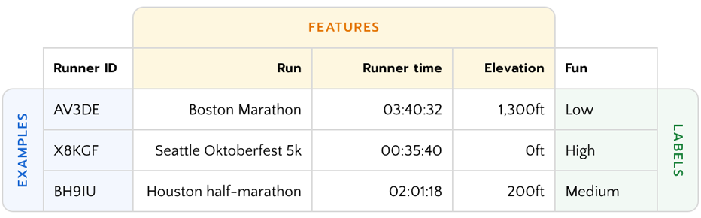
Terminology

Slide 18
Connectivity

Slide 19
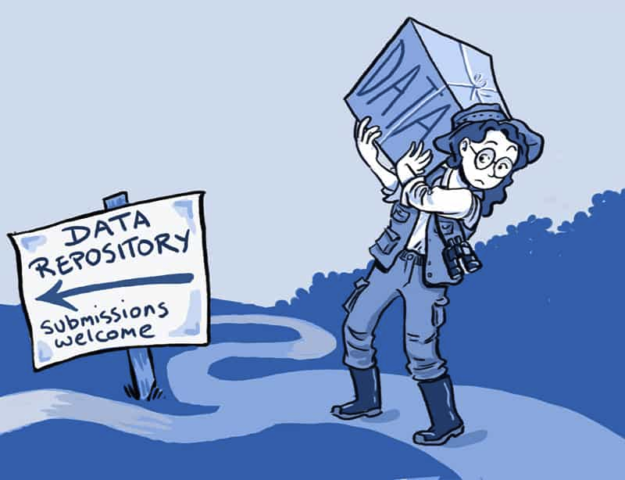
Connectivity
Python can be used to load data from almost any source
CSV, JSON and XLSX files
Remote databases
Custom local files
Web Scrapping
The only requirement is to arrange the data into Pandas Dataframes

Slide 20
Data cleaning/ transformation

Slide 21
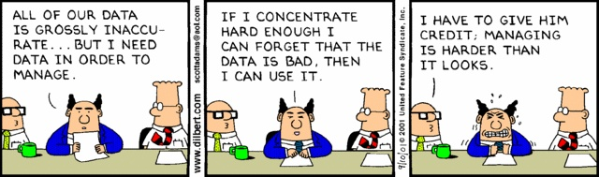
Bad Data…
Bad data is not criminal:
Mislabel or missing data
Redundant data
Outliers

Slide 22

Missing Data
When a feature has more than 90% examples missing, just drop it.
Replacement strategies:
Replace with a computed value:
Mean, median, most common
Value outside of range
∅
Interpolate missing value

Slide 23
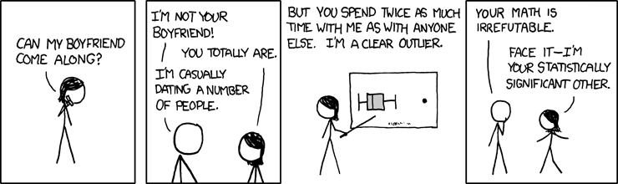
Outliers
Plot examples and manual remove outliers (small datasets)
Remove [1%, 5%, 10%] of the extremes
Use unsupervised learning methods to cluster data

Slide 24
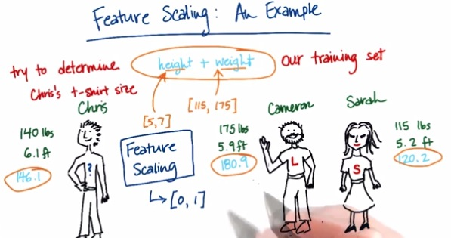
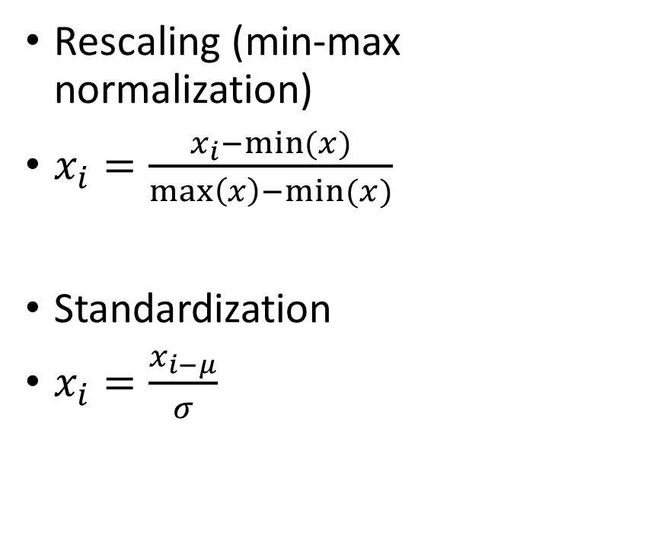
Data Normalization
Rescaling (min-max normalization)
$x_{i}=\frac{x_{i}−min⁡(x)}{\max\left(x\right)−min⁡(x)}$
Standardization
$x_{i}=\frac{x_{i−μ}}{σ}$

Slide 25
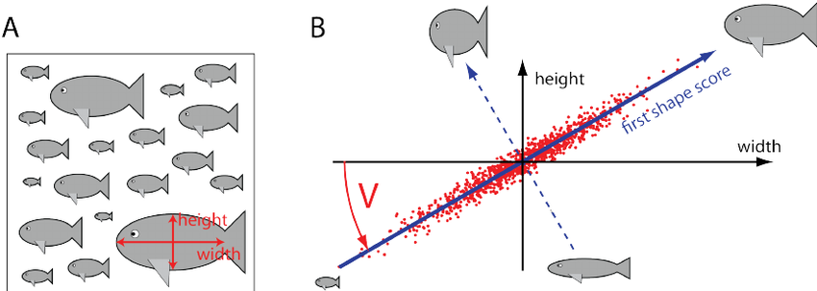
Expand/Reduce Features
Polynomial expansion
PCA

Slide 26
Machine Learning

Slide 27
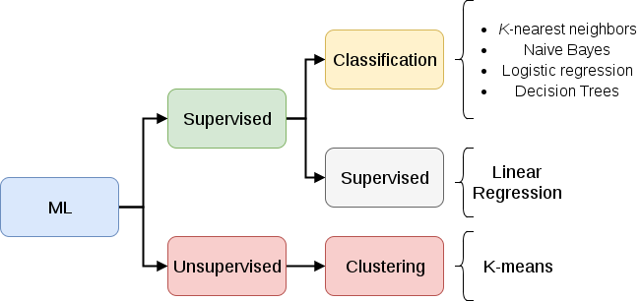
Taxonomies

Slide 28
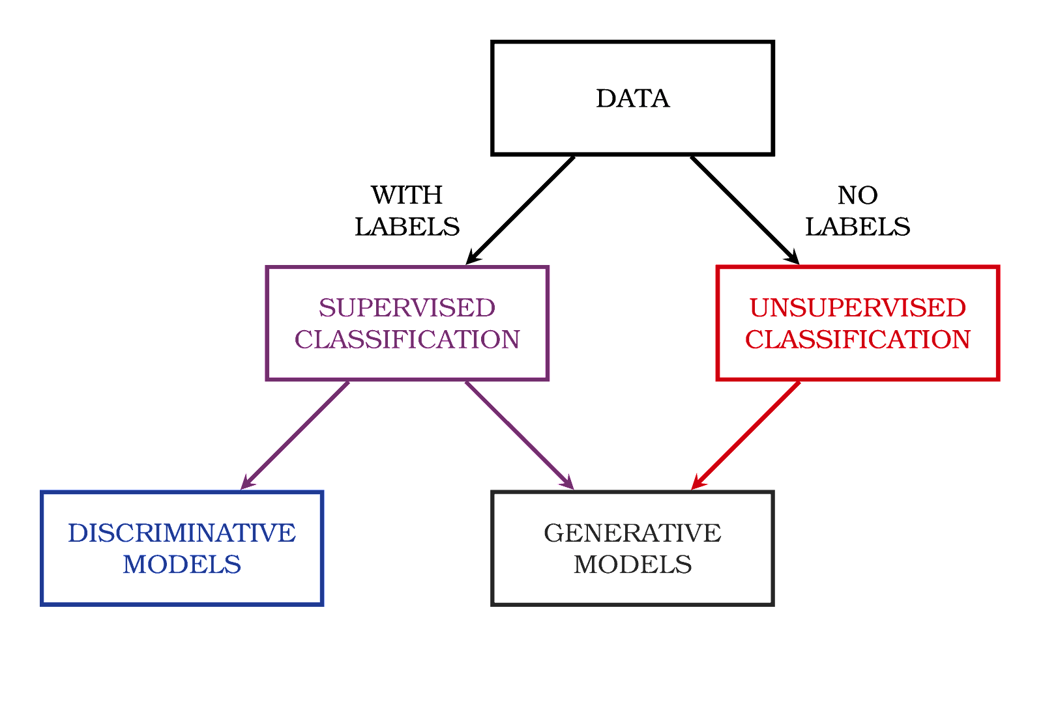
Taxonomies

Slide 29
Limitations

Slide 30
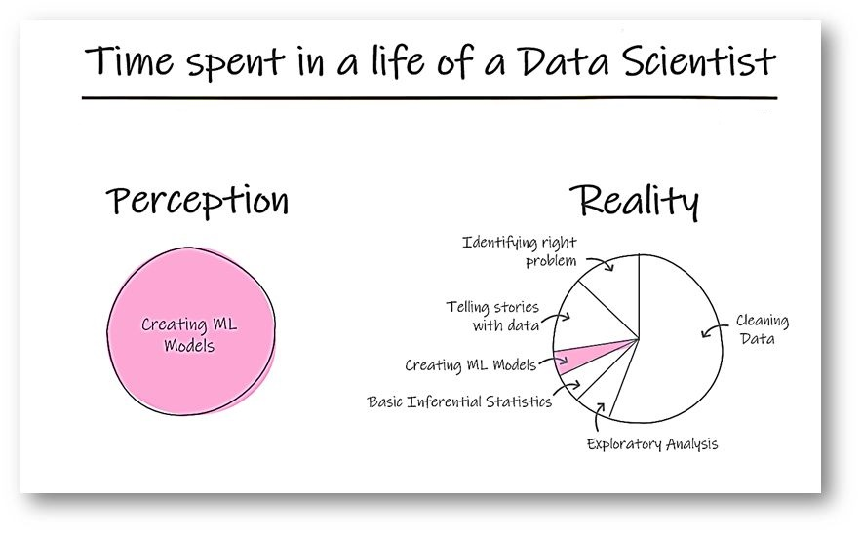
Limitations
Our model is a simplification of reality
Simplification is based on assumptions (model bias)
Assumptions fail in certain situations

Slide 31
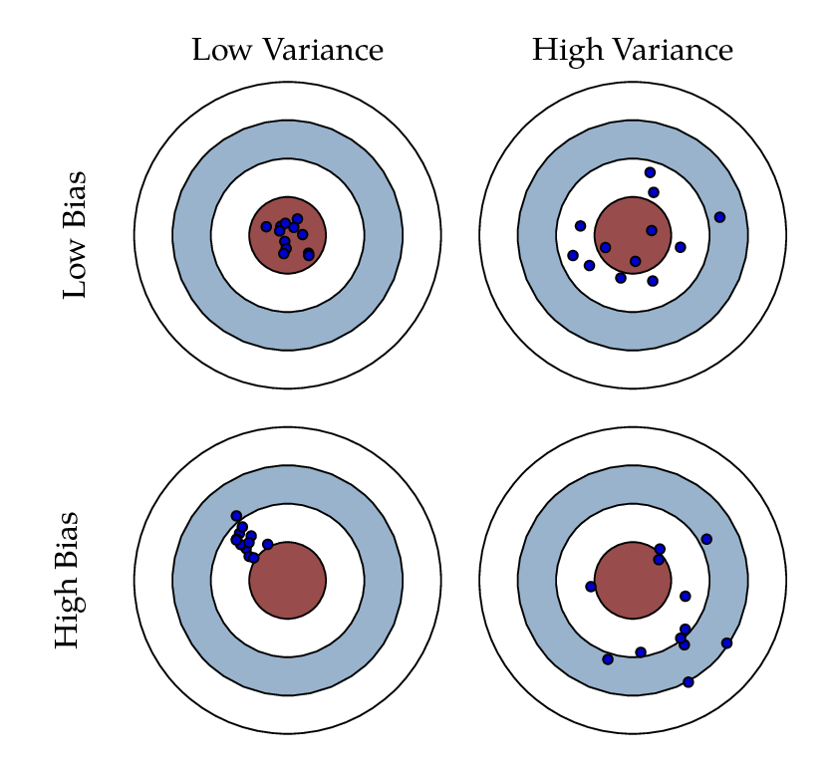
Bias and Variance

Slide 32
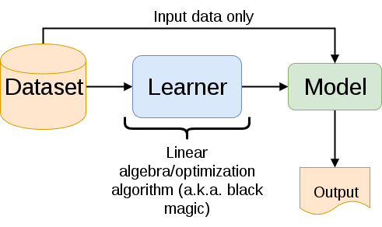
Training an ML model
There is a lot going on inside the model's code
But you do not have to worry about it (most of the time)
Different types of learners (with different assumptions)
Different types of data (numerical, stream, images, stock...)

Slide 33
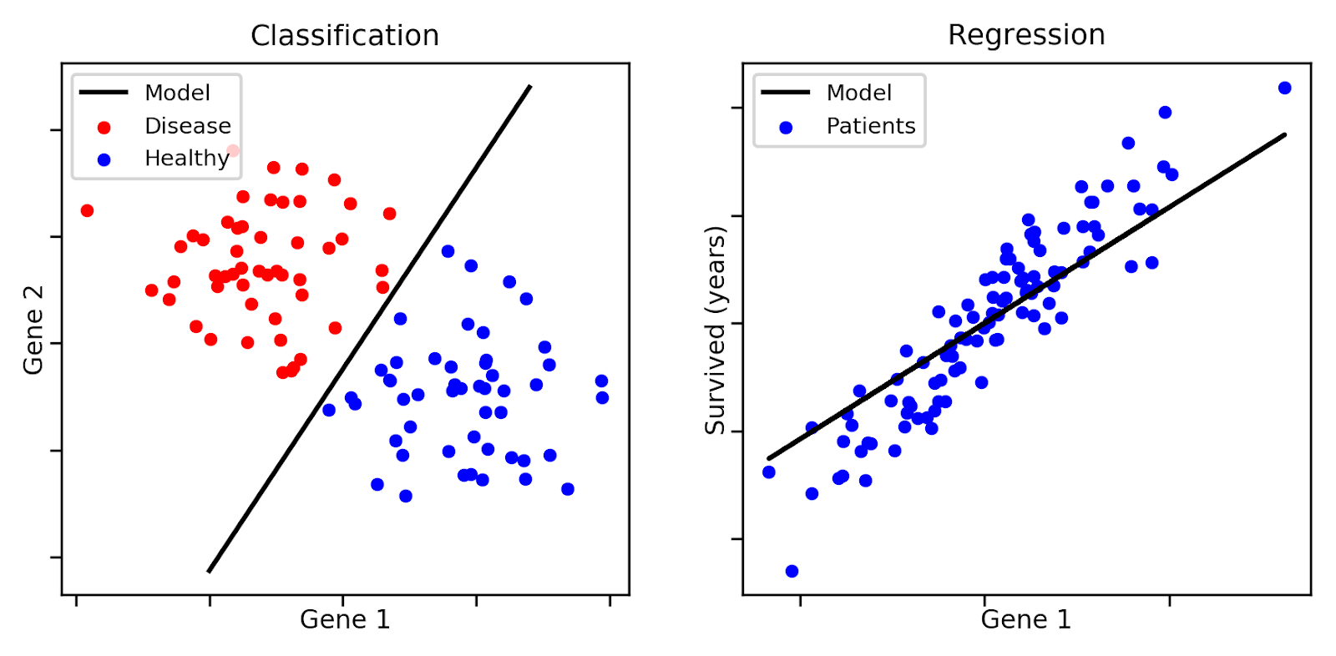
Classification & Regression
Given a labelled dataset learn a model that predicts the label
If the label is discrete: classification
On the other hand: regression

Slide 34
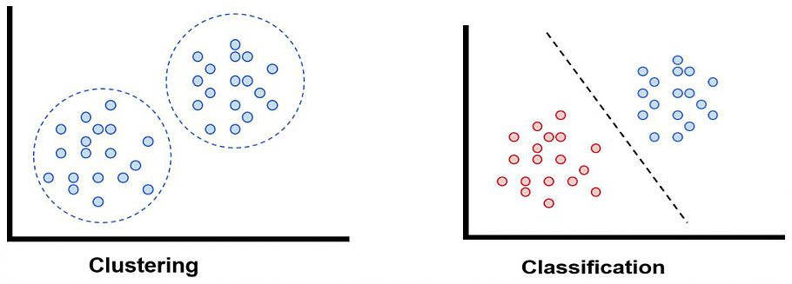
Clustering
The dataset does not have any labels
Find the major patterns in the examples

Slide 35

Reinforcement Learning
Reinforcement Learning: enables an agent to learn in an interactive environment by trial and error using feedback from its own actions and experiences.

Slide 36
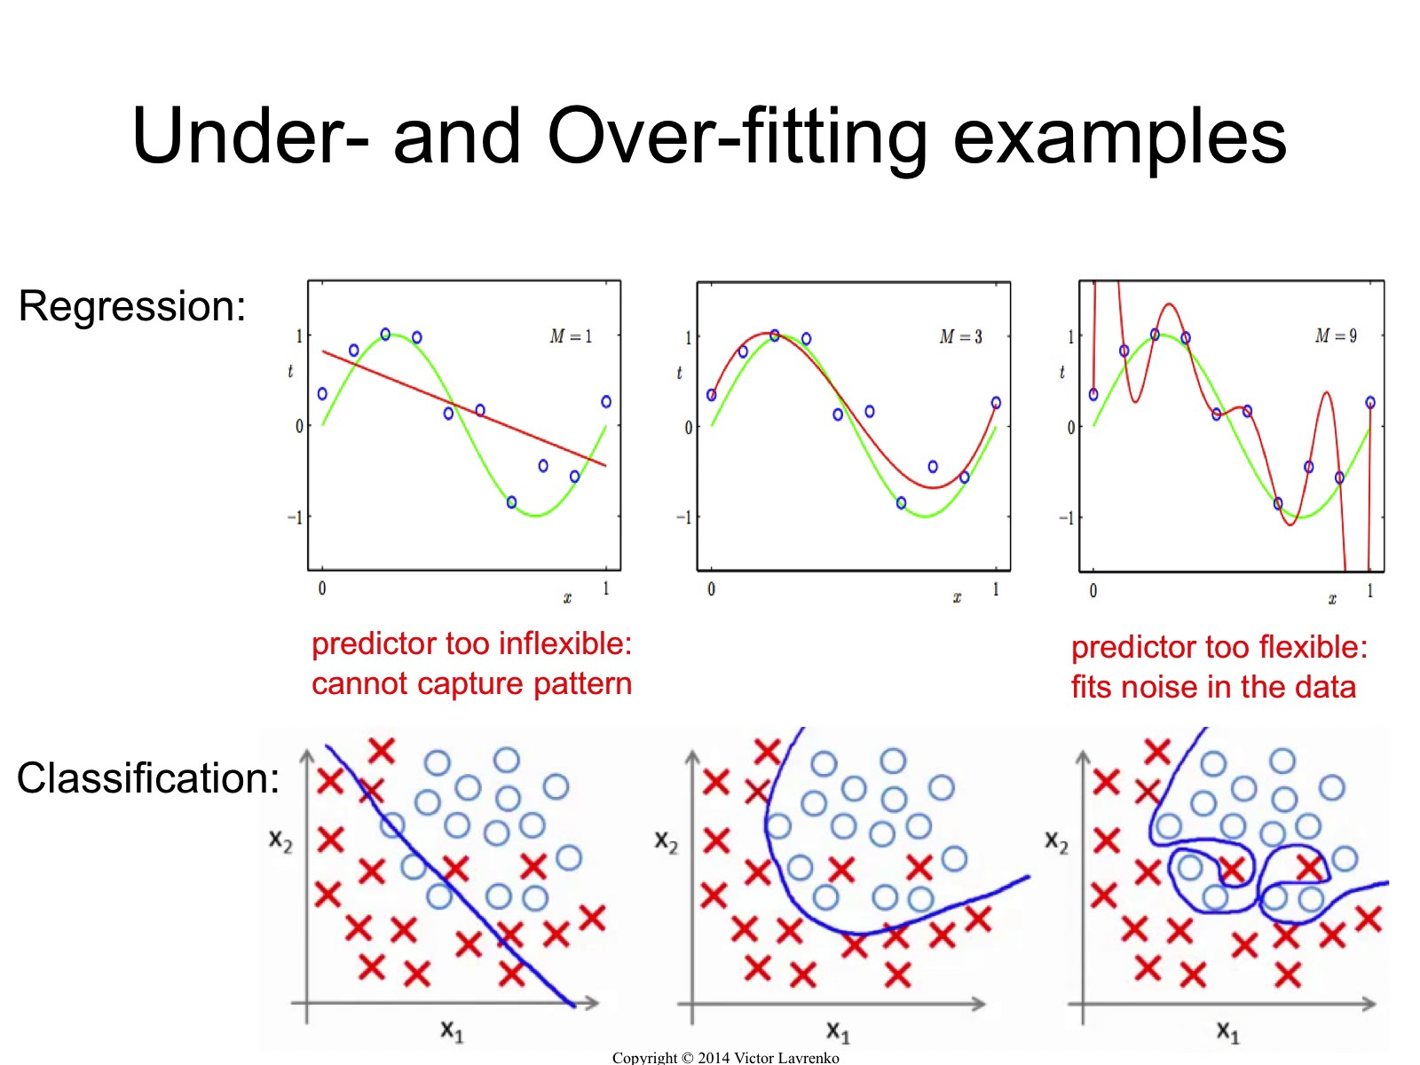
Model Evaluation
Generalization = min(overfitting + underfitting)
Overfitting = high variance
Underfitting = high bias

Slide 37
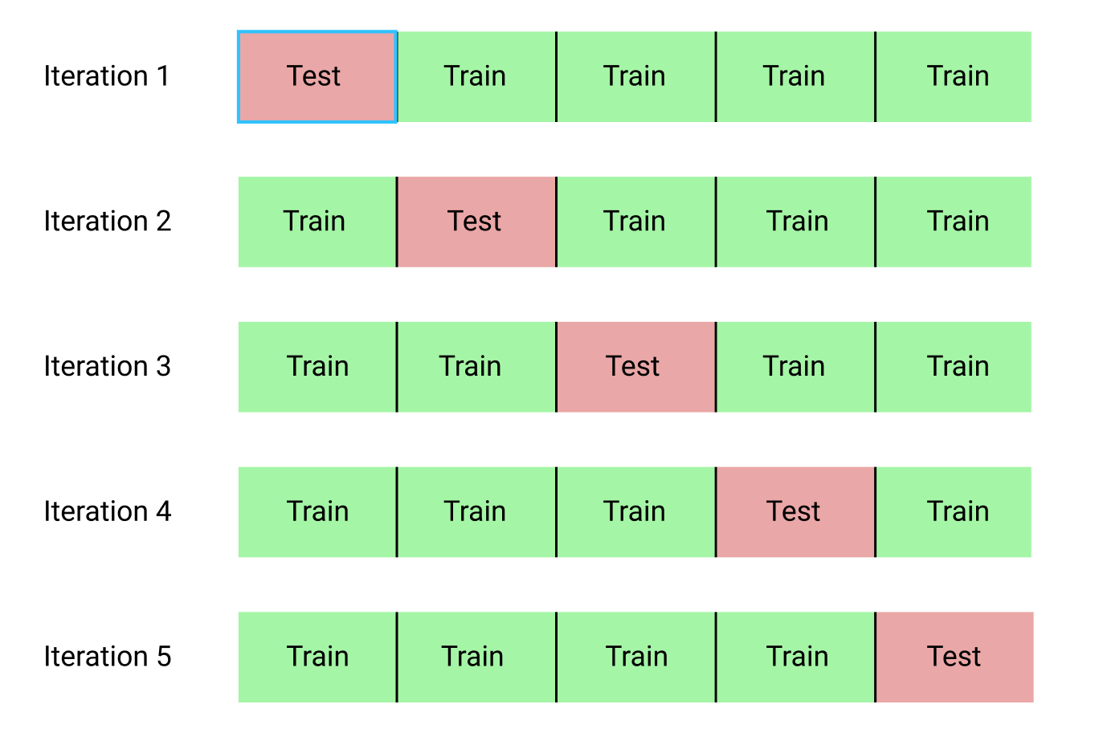
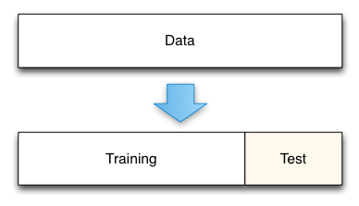
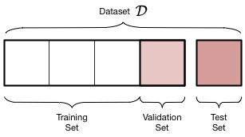
Validation

Slide 38
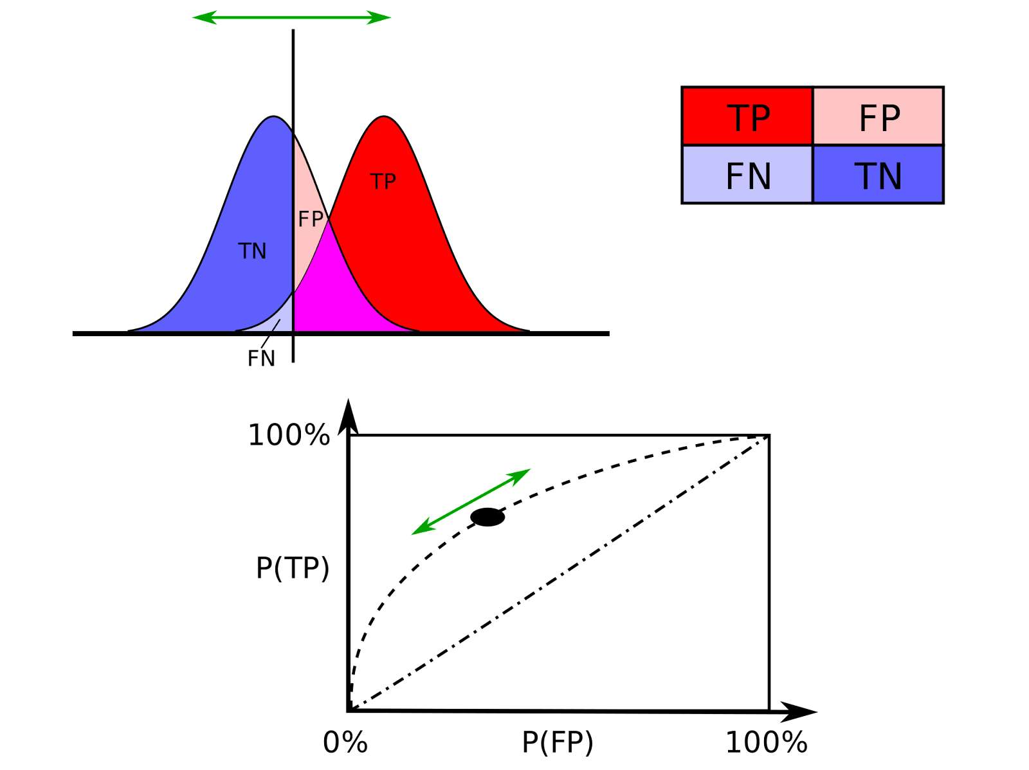
Metrics

Slide 39
Visualization

Slide 40
Visualization
Power Bi already support several visualization plots
However, it does not offer the flexibility of several Python libraries, such as Matplotlib and Seaborn
One can easily add Python code to plot data using this libraries

Slide 41
Project

Slide 42
Project
Load dataset demand.csv
The objective is to predict the number of units sold, based on the available information
Hint: use Machine Learning to predict the value

